Slide 1
MSc. Explainability & Reliability in Medical AI
Baseline CNN on FracAtlas
77%
ResNet-18 Transfer Learning — Binary Fracture Detection
Best Recall (E3)
3
Experiments Run
332
Test Images
Week 3–4 · FracAtlas Dataset (4,083 images) · Google Colab + Tesla T4 GPU · Feb 24, 2026

Slide 2
What Was the Goal for Weeks 3–4?
Build a stable baseline before any XAI
"Construct a baseline using fundamental CV/DL methods on FracAtlas — image labels ONLY. Use your own approach, not paper SOTAs. Record findings: detection performance, patterns, surprises."
— Supervisor Week 2 Feedback
🎯 Binary Classification Only
🔢 3-Step Experiment Plan
Fractured vs Non-Fractured
Image-level labels only — no bounding boxes, no CSV region annotations
E1 Feature Extraction (Frozen Backbone) → E2 Full Fine-Tune → E3 Fine Tune + Weighted Loss
Each step informs the next
🔬 No XAI Yet
📊 Record & Analyse Everything
Solid classification baseline comes first
XAI tools (Grad-CAM, CBM etc.) planned for later stages
Honest baseline enables fair later comparison
Track recall, precision, F1, AUC
Analyse errors by body part & view angle
Understand what the model misses and why

Slide 3
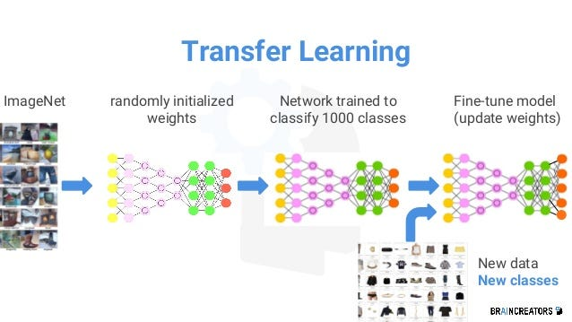

Why Transfer Learning + ResNet-18?
Starting from ImageNet knowledge rather than random weights
Why Transfer Learning?
Why ResNet-18 Specifically?
1
FracAtlas = only 717 fractured images
Criterion
Value
Why it matters
Far too few to train a CNN from scratch (needs 100k+)
Parameters
11.7M
Fast — ideal for baseline
2
ImageNet pre-training = free head start
Edges, textures, shapes already learned on 1.2M photos
Architecture
Skip connections
Stable gradients, no vanishing gradient
3
Low-level features DO transfer to X-rays
MURA (Stanford): DenseNet-ImageNet → radiologist-level bone X-rays
Pre-trained
ImageNet ✓
Strong visual features from day 1
4
Dramatically reduces training time
Hours on a single T4 GPU vs weeks from scratch
Literature
Medical standard
CBM paper: ResNet-18 on OAI bone X-rays
GPU cost
Low
Runs on free Colab T4 GPU

Slide 4
3-Step Experiment Design
Each experiment builds on the last — controlled progression
E1
Feature Extraction
E2
Full Fine-Tuning
E3
Weighted Loss
WHAT
WHAT
WHAT
Freeze all ResNet-18 layers.
Train only the final classifier head.
Unfreeze ALL layers.
Differential LR: backbone 1e-5, head 1e-3.
Same as E2 + class-weighted loss.
Fracture weight = 4.4× non-fracture.
→
→
WHY
WHY
WHY
Does ImageNet knowledge transfer to X-rays? Absolute minimum baseline.
Allow backbone to adapt to X-ray patterns (cortical edges, bone density).
Penalise missed fractures harder. Prioritise recall as the safety metric.
Recall: 45.9% | AUC: 0.80
Recall: 50.8% | AUC: 0.87
Recall: 77.0% | AUC: 0.87 ← Best

Slide 5
Experiment Design — 3-Step Transfer Learning
E1 — Feature Extraction
E2 — Full Fine-Tune
E3 — Weighted Loss
Frozen backbone
All 11.2M params
Clinical priority
Only train the final classification head (1,026 params). ImageNet features unchanged. Fast baseline — does pretrained knowledge transfer at all?
Unfreeze entire ResNet-18. Very low backbone LR (1e-5) to preserve ImageNet knowledge, higher head LR (1e-3). Allows X-ray adaptation.
Same as E2 but CrossEntropy weighted 2.85× for fractured class. Penalises missed fractures more than false alarms. Optimised for recall.
Shared Setup: FracAtlas official splits (574 train / 82 val / 61 test fractured) · ResNet-18 ImageNet pretrained (11M parameters) · 30 epochs, Adam, ReduceLROnPlateau · 224×224 px · Weighted class recall as primary metric
Why ResNet-18?
Why image labels only?
Why Recall as primary?
Proven on bone X-rays (CBM paper), fast, 11.7M params — not too big to overfit 717 fractured images.
No bounding boxes. Forces model to learn from full X-ray — realistic clinical conditions.
In screening, missing a fracture (FN) is worse than a false alarm (FP). Recall = clinical safety metric.

Slide 6
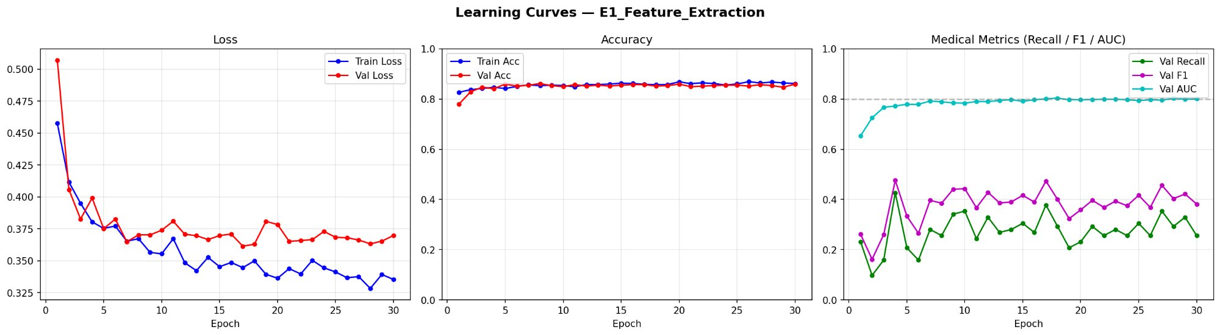
E1 — Feature Extraction: Learning Curves
Frozen backbone | Only final classifier head trained | 30 epochs
📉 Loss converges but val > train — ImageNet features not X-ray adapted
📊 ~87% accuracy misleading — majority class dominates predictions
⚠️ Val Recall oscillates 20–40% — barely detects fractures
🔵 AUC 0.80 — discriminative power exists, threshold is wrong

Slide 7
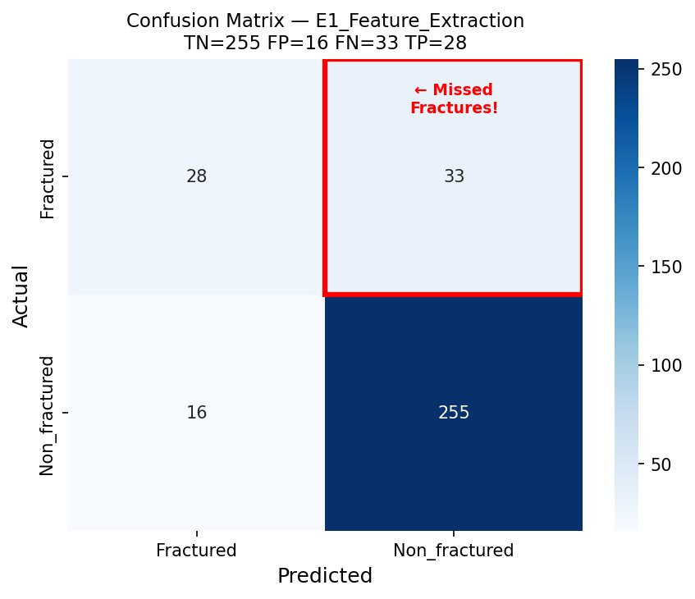
E1 — Verdict: 46% Recall — Not Clinically Viable
TN=255 FP=16 FN=33 TP=28 | Recall=45.9% Precision=63.6% F1=0.53 AUC=0.80
33 Missed Fractures (FN)
More than half of actual fractures called 'Normal'. 33 patients sent home without diagnosis — clinically unacceptable.
Root Cause: Frozen features
ImageNet features (objects, scenes) forced to classify X-rays unchanged. Model defaults to 'non-fractured' (safer prediction for majority class).
87% Accuracy is Deceptive
Predicting ALL images as non-fractured gives 80% accuracy. E1 is barely better than a trivial classifier for the minority fracture class.
AUC=0.80 — Signal Exists
Despite poor recall, AUC shows the model CAN rank fractures vs non-fractures. Full fine-tuning may unlock this discriminative ability.
→ E1 shows transfer learning works in principle. Full fine-tuning needed to unlock it.

Slide 8
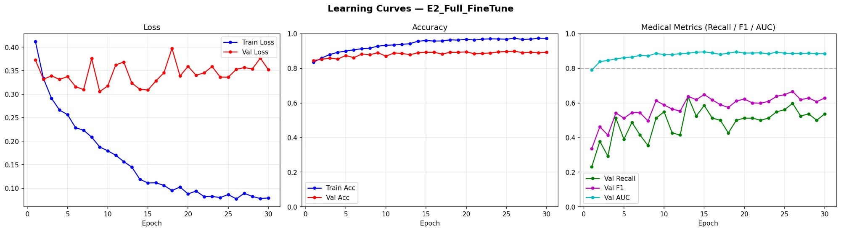
E2 — Full Fine-Tuning: Learning Curves
All layers unfrozen | Differential LR: backbone 1e-5, head 1e-3 | 30 epochs
📉 Train loss → 0.08 — model fully adapts to X-ray data
⚡ Val loss oscillates — overfitting gap widens after epoch 15
📈 Val Recall 40–60% — improvement over E1 but inconsistent
🔵 AUC 0.87 — backbone features now X-ray adapted

Slide 9
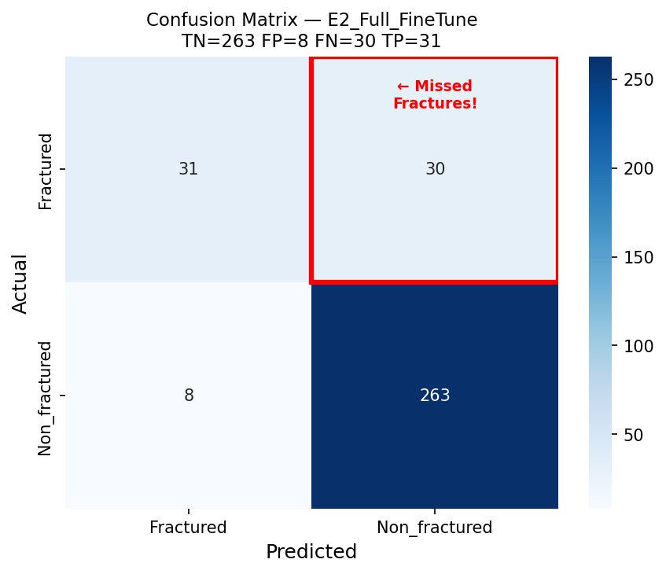
E2 — Verdict: 51% Recall — Improved But Still Insufficient
TN=263 FP=8 FN=30 TP=31 | Recall=50.8% Precision=79.5% F1=0.62 AUC=0.87
Still 30 Missed Fractures (FN)
Only 3 fewer than E1. Recall 50.8% — still missing half of all fractures. The model improved its confidence, not its coverage.
Precision 79.5% — FP dropped to 8
When the model says 'fracture', it is more often right. False alarms halved. Precision-recall trade-off beginning to show.
Overfitting Pattern Visible
Train loss 0.08 vs Val loss 0.35. Memorising training data. Generalisation to new X-rays is the challenge.
AUC 0.87 — Genuine Improvement
Ranking ability confirmed. The model can separate fractures from non-fractures; the problem is the classification threshold. Weighted loss should fix this.
→ E2 proves fine-tuning adapts features. Recall-precision balance still needs class weighting.

Slide 10
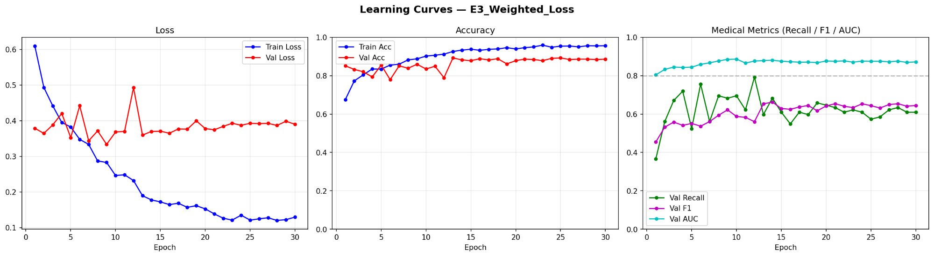
E3 — Weighted Loss: Learning Curves
Class weight: fracture = 4.4× | Penalises missed fractures harder | 30 epochs
🎯 Val Recall stabilises 60–75% — weighted loss strategy worked
📈 Val Accuracy holds ~87% — no catastrophic precision collapse
⚡ Loss starts higher (0.6) — weighted penalty reshapes loss landscape
✅ AUC 0.87 maintained — ranking ability preserved while recall grows

Slide 11
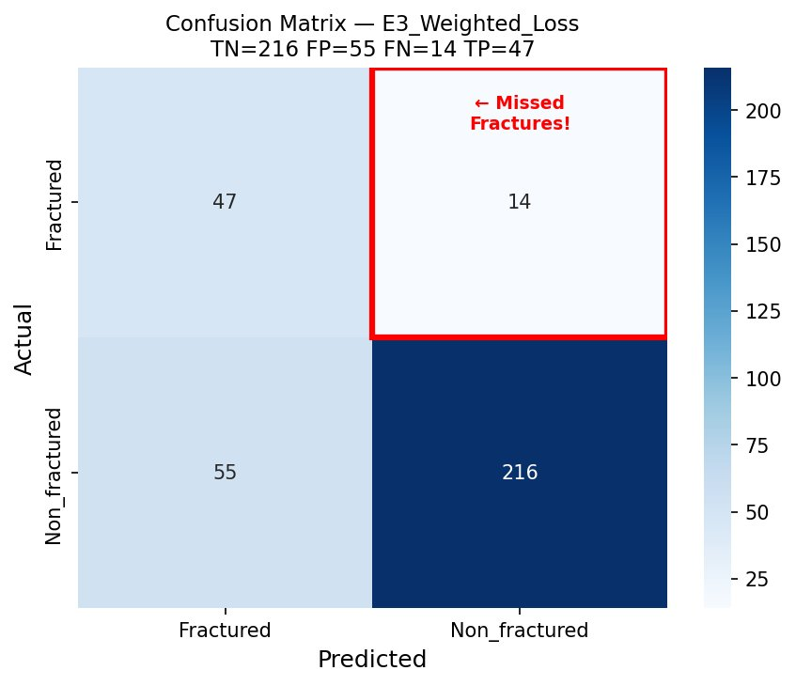
E3 — Verdict: 77% Recall — The Baseline is Set
TN=216 FP=55 FN=14 TP=47 | Recall=77.0% Precision=46.1% F1=0.58 AUC=0.87
Only 14 Missed Fractures (FN)
Down from 33 (E1). 47/61 fractures correctly found. 67% reduction in dangerous misses — the weighted loss directly translated to patient safety.
55 False Alarms — Accepted Trade-Off
More healthy patients flagged for review. In medical AI, this is ACCEPTABLE: over-referral is manageable; missed fractures are not.
Class Weight = 4.4× for Fractures
Mathematical translation of clinical priority. Each training miss counts 4.4× worse than a false alarm — encoding domain knowledge into the loss.
Strong Baseline for Week 5
77% recall with no XAI, no bounding boxes, no augmentation. Every remaining miss is a specific body-part challenge — identifiable and addressable.
→ E3 is our confirmed baseline. Remaining misses are body-part specific — analysed on next slides.

Slide 12
Results — Weighted Loss Is the Clinical Choice
E1 Recall
45.9%
Frozen backbone
E2 Recall
50.8%
+ full fine-tune
E3 Recall
77.0%
+ weighted loss ★
Clinical Interpretation
E3 catches 15 of 19* missed fractures that E2 left undetected. The precision drop (0.795→0.461) means more false alarms — acceptable in screening where missing a fracture is the greater harm.
* Approximate — based on test set of 61 fractured images. Primary metric = Recall (Sensitivity).

Slide 13
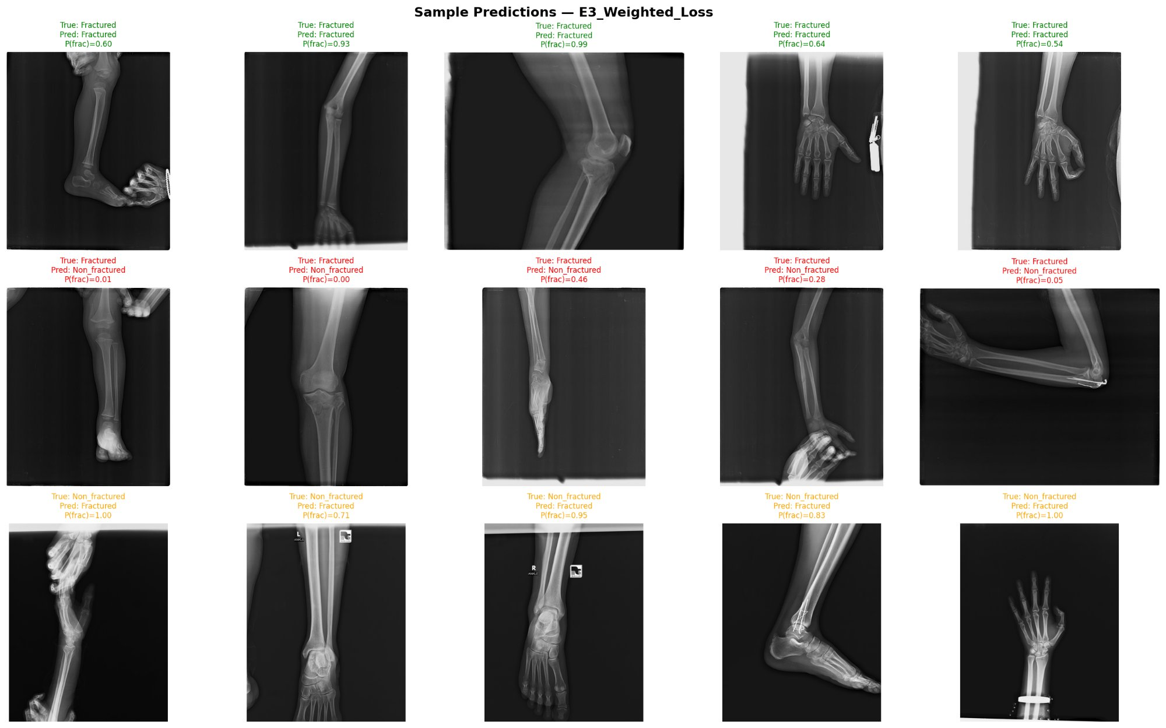
What Does the Model Actually See? — E3 Sample Predictions
Row 1: Correct detections (TP, green) | Row 2: Missed fractures (FN, red) | Row 3: False alarms — healthy flagged as fractured (FP, orange)

Slide 14
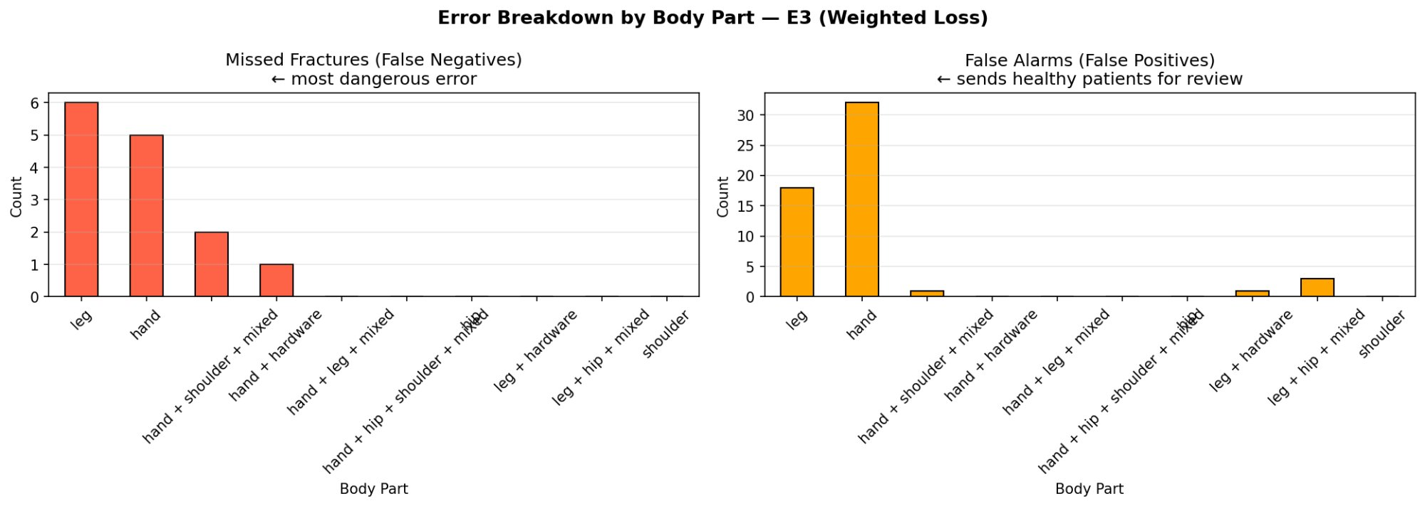
Error Breakdown by Body Part — E3
Where does the model fail? False Negatives (missed fractures) vs False Positives (false alarms)
Leg: 6 FN (most dangerous)
Hand: 31 FP (most alarming)
Errors concentrated in 2 classes
Shoulder/Hip: 0 FN
Highest missed fracture count. Long-bone cortical breaks can be very subtle — thin hairline cracks.
Model massively over-detects in hands. Surgical hardware (pins, plates) likely confuses it with fracture patterns.
Leg + Hand account for 85%+ of all errors. Targeted augmentation for these two could significantly improve baseline.
Zero missed fractures — but small sample size means low statistical confidence. Need more examples to confirm.

Slide 15
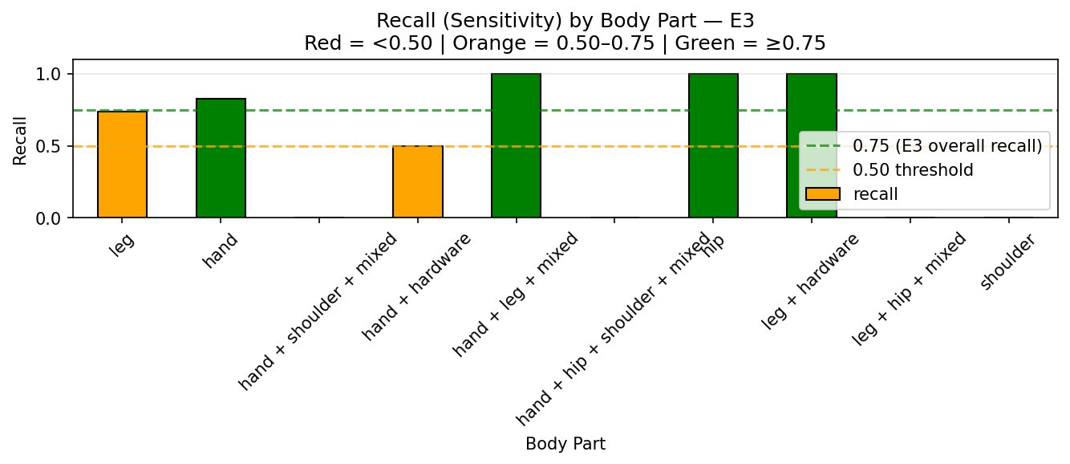
Recall by Body Part — Where Does the Model Excel?
Green ≥0.75 (clinically good) | Orange 0.50–0.75 (marginal) | E3 overall recall dashed line at 0.77
Hand: 85% recall
Leg: 75% recall
Hand+Hardware: 50%
Multi-view = 100%
Largest class → most training examples → best learned. Strong foundation for Hand-specific XAI.
Right at the E3 average. 6 FNs in absolute count. Most important class to improve next.
Surgical hardware confuses features. Hardware-aware preprocessing or augmentation needed.
Frontal+lateral together → perfect recall. Key implication: dual-view protocols improve safety.

Slide 16
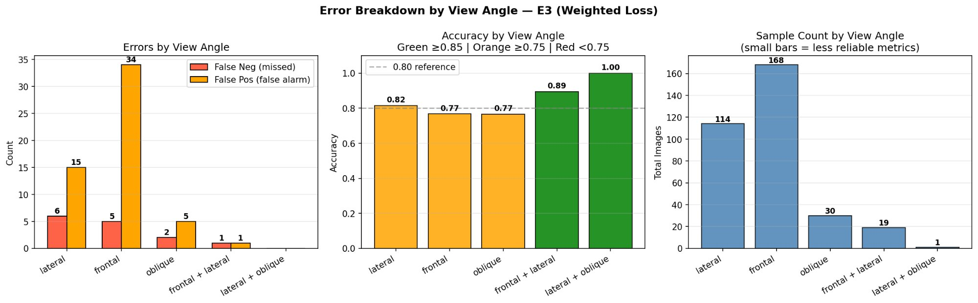
Does View Angle Affect Performance? — E3
Lateral vs Frontal vs Oblique vs Combined — Error counts, accuracy, and sample sizes
Frontal: 34 FP (volume issue)
Frontal accuracy: 77%
Frontal+Lateral: 89% accuracy
Oblique views: distinctive
168 images = most common. High FP count from sheer volume, not lower accuracy per image.
Just below the 0.80 reference. More diverse fracture appearance in frontal views.
Best among well-sampled groups. Consistent with body part analysis — dual view helps.
Lower error rate where sampled. Suggests oblique angles may provide complementary information.

Slide 17
Summary & Week 5 Directions
What we learned — what comes next
KEY FINDINGS
WEEK 5 DIRECTIONS
✅ 77% recall achieved — E3 weighted loss is our confirmed baseline
Baseline Hardening
A
Augmentation targeting leg/hand. Investigate hardware mislabeling.
✅ Full fine-tuning: +5% recall and +0.07 AUC over feature extraction
B
Grad-CAM Visualisation
✅ Multi-view (frontal+lateral) scans yield 89% accuracy
First XAI: where does the model look? Are regions clinically sensible?
⚠️ 14 fractures still missed — Leg (6) and Hand (5) are priority targets
C
Concept Bottleneck Prototype
Define 3–5 clinical concepts (cortical break, displacement) and begin CBM design.
⚠️ Hardware in hands causes 32 false positives — dataset confound
⚠️ Precision 46% — acceptable for screening, not standalone diagnosis
D
Supervisor Input Required
Improve recall further OR move to XAI? Direction decision needed.

